Slide 1
Project Report On Python PERSONAL ASSISTANT (J.A.R.V.I.S) Under the guidance of: Priti Sardar from Indian Cyber Security Solutions Submitted By- Aakash Das Roll No: 1705841 Branch: CSE Semester: 5th Kalinga University of Industrial Technology Submitted Date:08/06/2019

Slide 2
Table of Contents:
Title Pages……………………...........................................................….1
Table of Contents………………………………..................................…..2
Project Management Plan……………………………..................……….3
Overview Scope and Objectives………………….....…................……...4
Assignment of Roles and Responsibilities…………......…..........………5
Project Schedule...............................................................................…6
Requirements Specifications………......................................................7
Analysis-Design……………………………....................................…8-12
Implementation-Test …………………………….….........….............13-15
References…………………………………...........................................16

Slide 3
Project Management Plan:
The management plan defines the purpose of the project and its organization.
Overview the project :
It specify, Speech recognition can by done using the Python Speech Recognition module. I make use of Google Speech API because of it’s great sound capture quality.
Specifications:
1. Recent Time Speaking
2. Question - Answer Speaking
3. Search Wikipedia with speaking - printing
4. Wi-Fi Checking(ON/OFF)
5. Open Any Website
6. Talking Shutdown
7. Open Any Specific Website by OS
8. Open and Play Movies or Songs From File Directory
9. Open Any Application by OS
10. Email Sending by Command

Slide 4

Project scope and objectives:
I ran into difficulties defining the boundaries of what would be included in the project and what would not. This is because of the open-ended nature of the project. Many different ideas and pieces of functionality had potential to be incorporated into the application. I wanted to be as open as possible when considering features, so it became difficult to say no to different parts of the system. This resulted in pieces of the system that were not developed as completely as they could have been. Future projects should have a clearly defined scope that teams can commit to. The team believes that since the scope was so large, there was no chance of completing everything in the project, which hurt the overall motivation on the project.
Objectives goes to next generation of project by python(text to speech)

Slide 5
Assignment of Roles and Responsibilities:
This .is a personal project of python. I tried my best to do.
This project works like a J.A.R.V.I.S or a personal assistant.
It works 10 different things in one project like;
A. Recent Time Speaking
B. Question - Answer Speaking
C. Search Wikipedia with speaking - printing
D. Wi-Fi Checking(ON/OFF)
E. Open Any Website
F. Talking Shutdown
G. Open Any Specific Website by OS
H. Open and Play Movies or Songs From File Directory
I. Open Any Application by OS
J. Email Sending by Command
Main Motive: “10 Specifications = 1 PROJECT”

Slide 6

Project Schedule:
Each phase of project development will be given a timeline.
This project was completed around in 1 Month.
I implemented each specification in various time of this project and sorted out a shortest way for implementing this project.

Slide 7
Requirements Specifications:
This section will consist of a requirements document outlining the system
Installation:-
a)import pyttsx3:
Pyttsx3 is a text-to-speech conversion library in Python. Unlike alternative libraries, it works offline, and is compatible with both Python 2 and 3.
pip install pyttsx3
b)import speech_recognition as sr:
SpeechRecognition 3.8.1 is the library for performing speech recognition, with support for several engines and APIs, online and offline.
pip install SpeechRecognition
c)import datetime:
This package provides a DateTime data type, as known from Zope. Unless you need to communicate with Zope APIs, you're probably better off using Python's built-in datetime module.
pip install DateTime
d)import wikipedia:
Wikipedia is a Python library that makes it easy to access and parse data from Wikipedia.
pip install wikipedia
e)import webbrowser:
By default, It saved in Python Package
f)import os:
By default, It saved in Python Package(os-operating system
g)import smtplib:
For sending gmail by voice use smtplib

Slide 8
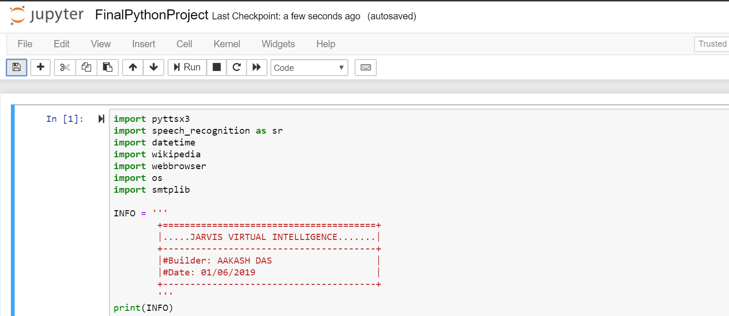

Analysis- Design: This section will document my analysis-design model.
Import Packages:
Output:

Slide 9
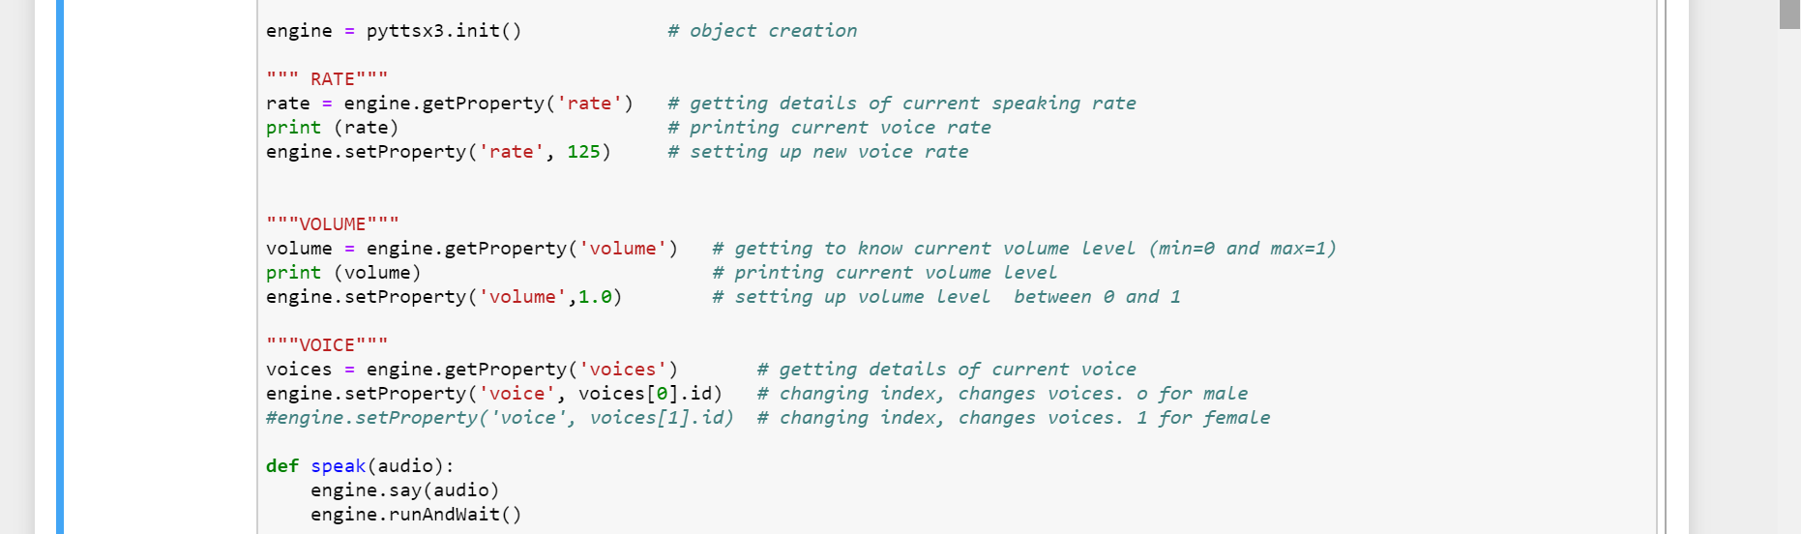
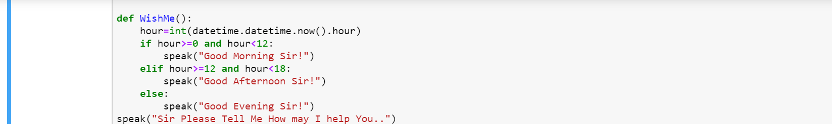
Analysis - Design...
For 'pyttsx3' Package Work:
WishMe First:

Slide 10
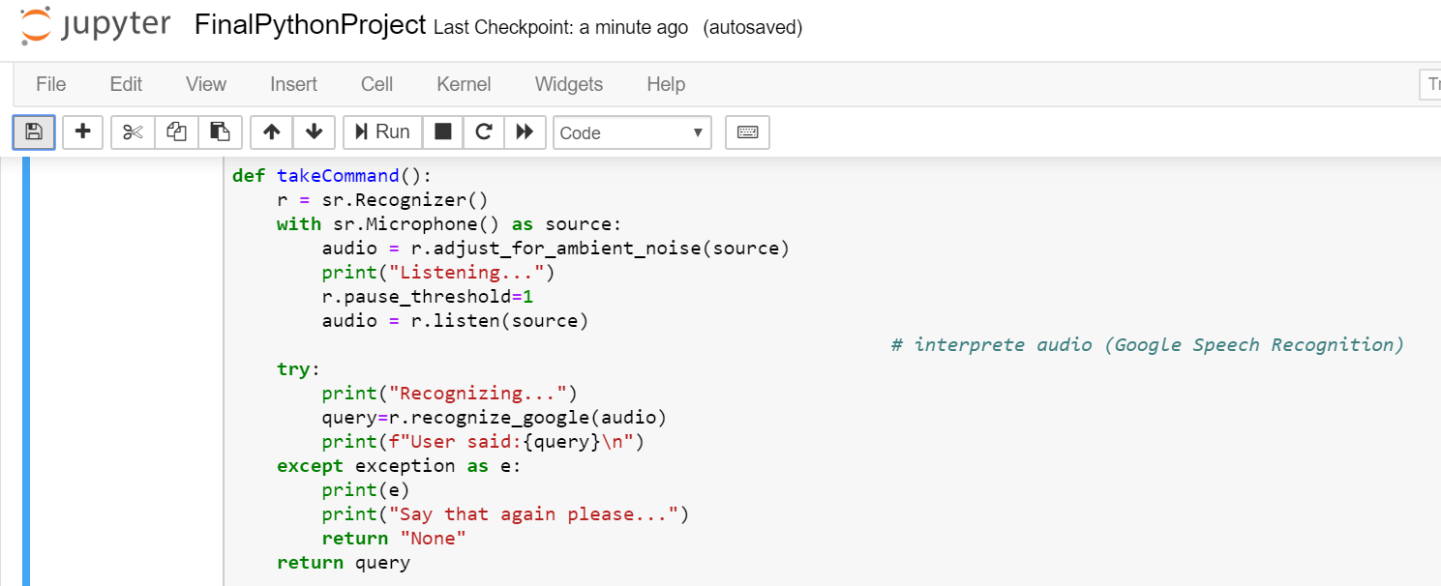
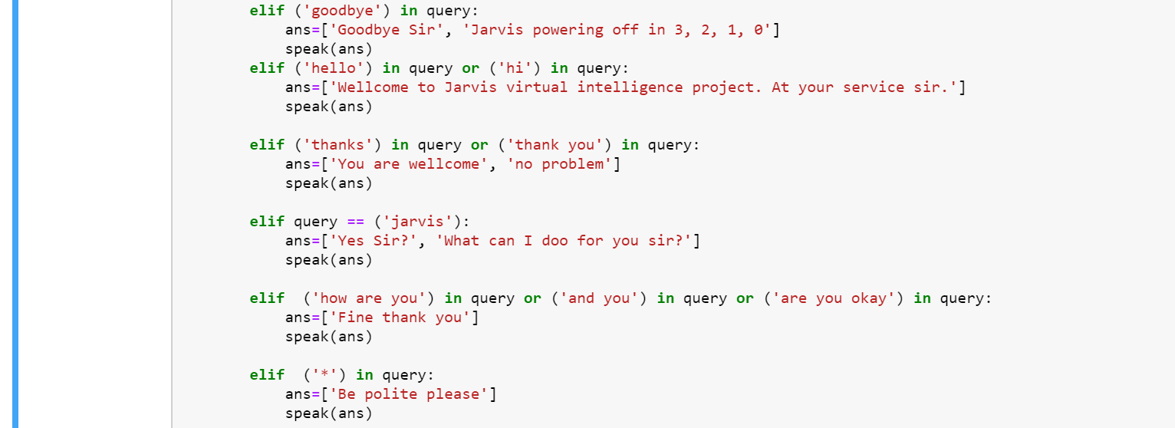
Analysis - Design...
Taking command:
Question-Answer Speaking:

Slide 11


Analysis - Design...
Wikipedia Opening:
App Opening(like Stream):

Slide 12


Analysis - Design...
Wi-fi Connecting:
Any Wbsite Opening:

Slide 13


Analysis - Design...
Sleep Mode On:
Play Movies From Dictionary:

Slide 14
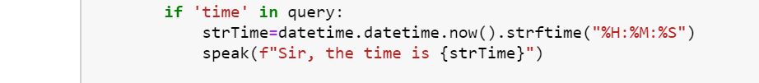
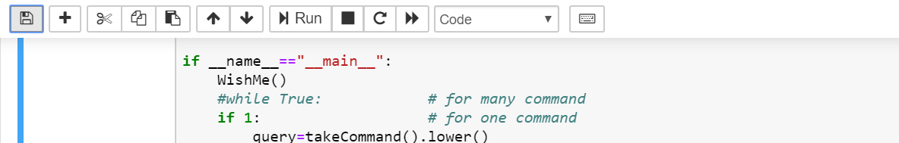
Analysis - Design...
Time Speaking:
Taking Command:

Slide 15
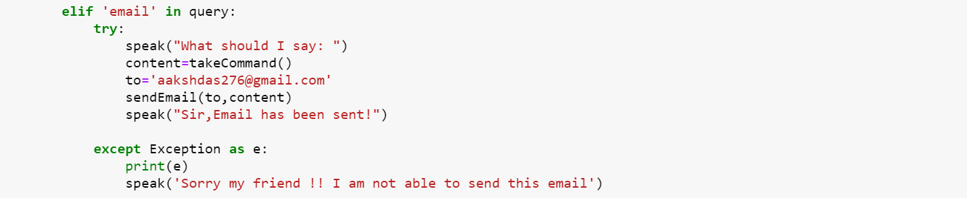

Analysis - Design...
Email Checking:
Email-Server Checking:

Slide 16
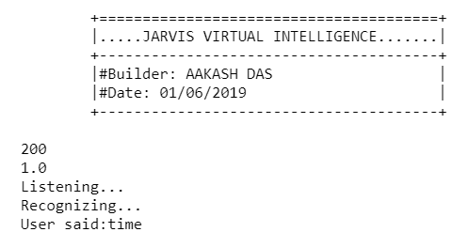
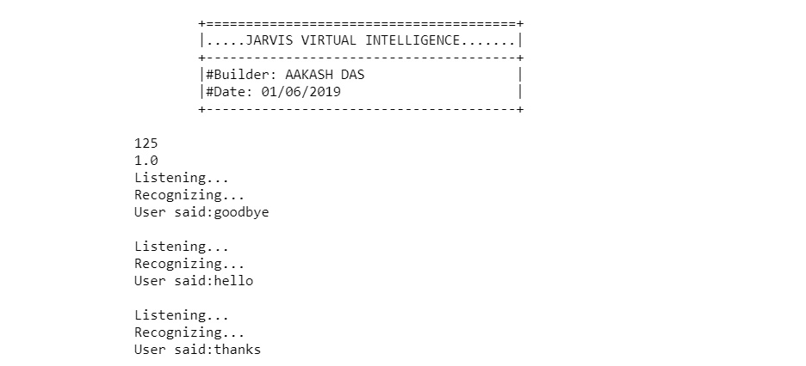
Implementation-Test Documentation:
Real-Time Speaking:
Question-Answer Speaking:

Slide 17
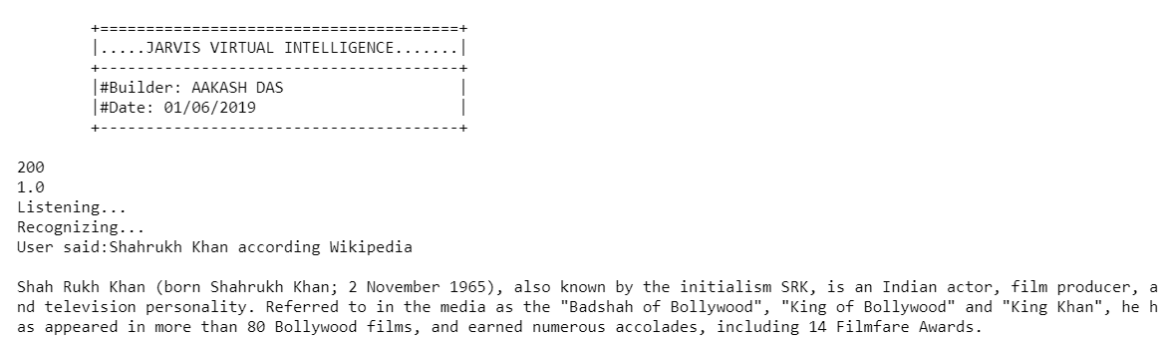
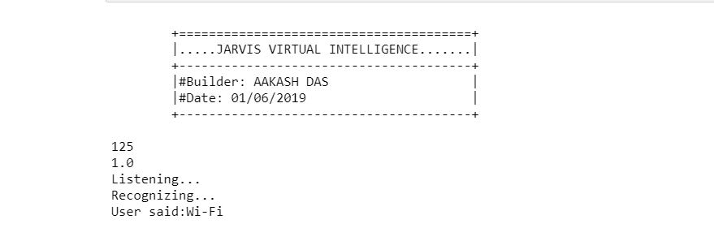
Implementation-Test Documentation...
Search In Wikipedia
Wi-Fi Checking:

Slide 18
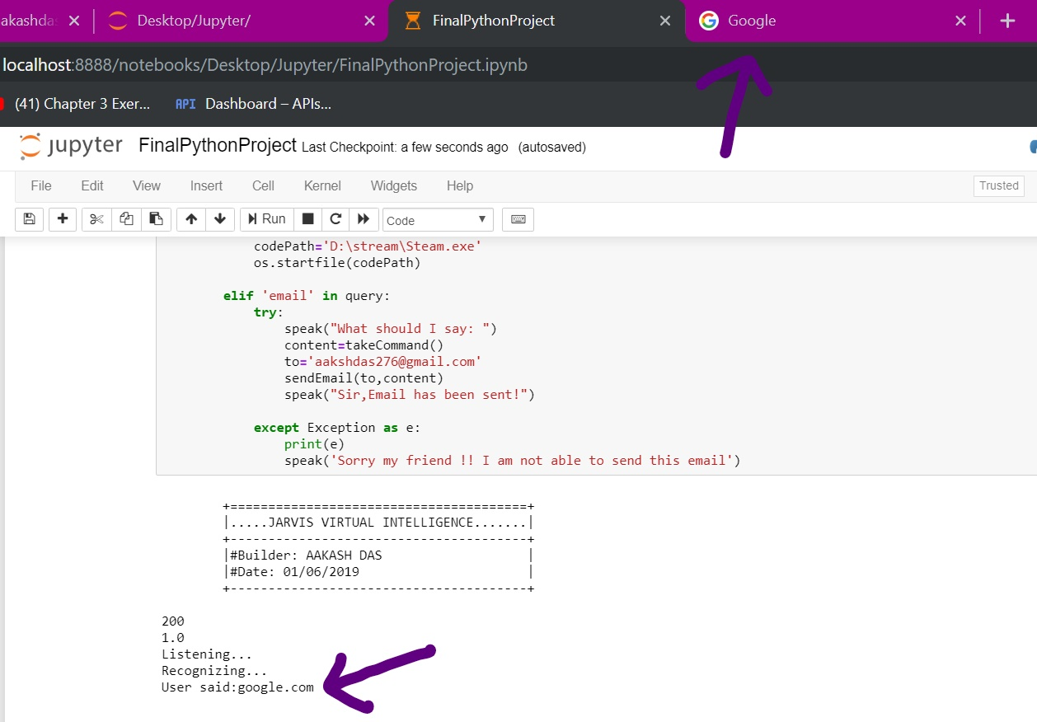
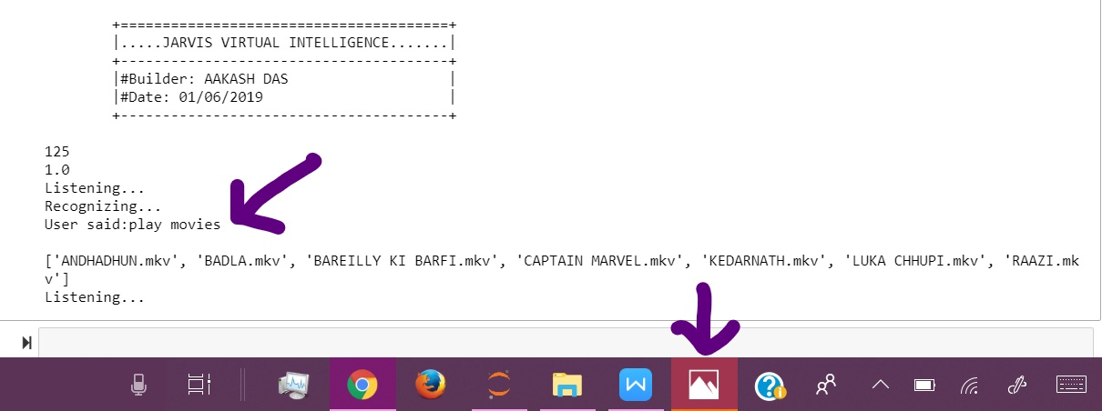
Implementation-Test Documentation...
Website Opening:
Movie Open:

Slide 19
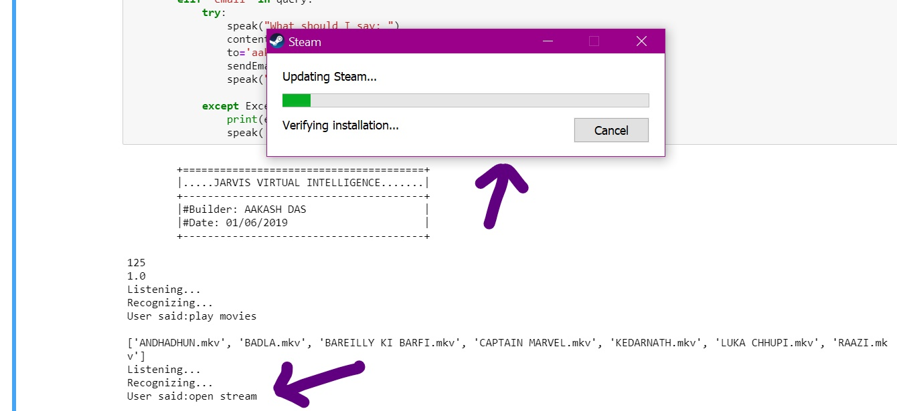
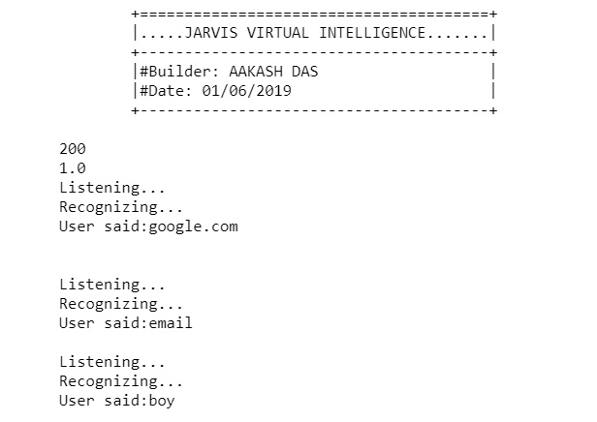
Implementation-Test Documentation...
Stream Open:
Email Sending:

Slide 20
References:
I completed this project under the guidance of: Priti Sardar Ma'am
from Indian Cyber Security Solutions and also helped from Internet specially Git Hub website.

Slide 21
THANK YOU!!!

